Slide 1

Mushroom Classification
Mushroom Classification
Sophina Nichols

Slide 2
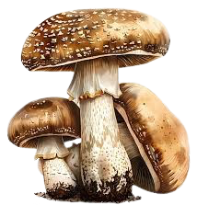
Problem
Problem:
Training machine learning classification models on a labeled dataset of mushroom characteristics to develop an automated system that accurately classifies mushrooms as poisonous or edible based on their attributes.

Slide 3
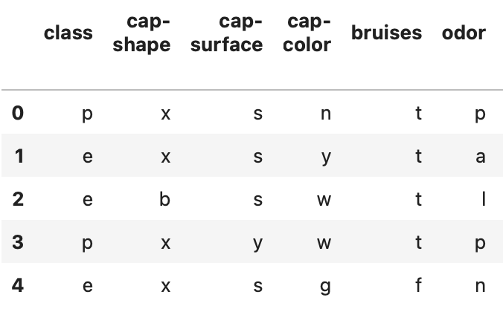
Dataset Overview
Shape: 8124 x 23
Info: categorical
Target: class
Features: cap-shape, cap-color,
cap-surface, bruises, odor, …
Notes:
Shape: 8124 (rows) x 23 (columns) <-meaning there are roughly 8000 instances, 22 features and 1 target.

Slide 4
Data Preprocessing
– Replaced missing values in ‘stalk-root’ with mode of column
– Separated dataset into features (X) and target (y)
– Used OneHotEncoder to convert features to numeric format
– Split dataset into training and testing sets
– Scaled features using StandardScaler

Slide 5
Models Implemented
Logistic Regression
K-Nearest Neighbors
Neural Network
Random Forest
XGBoost

Slide 6
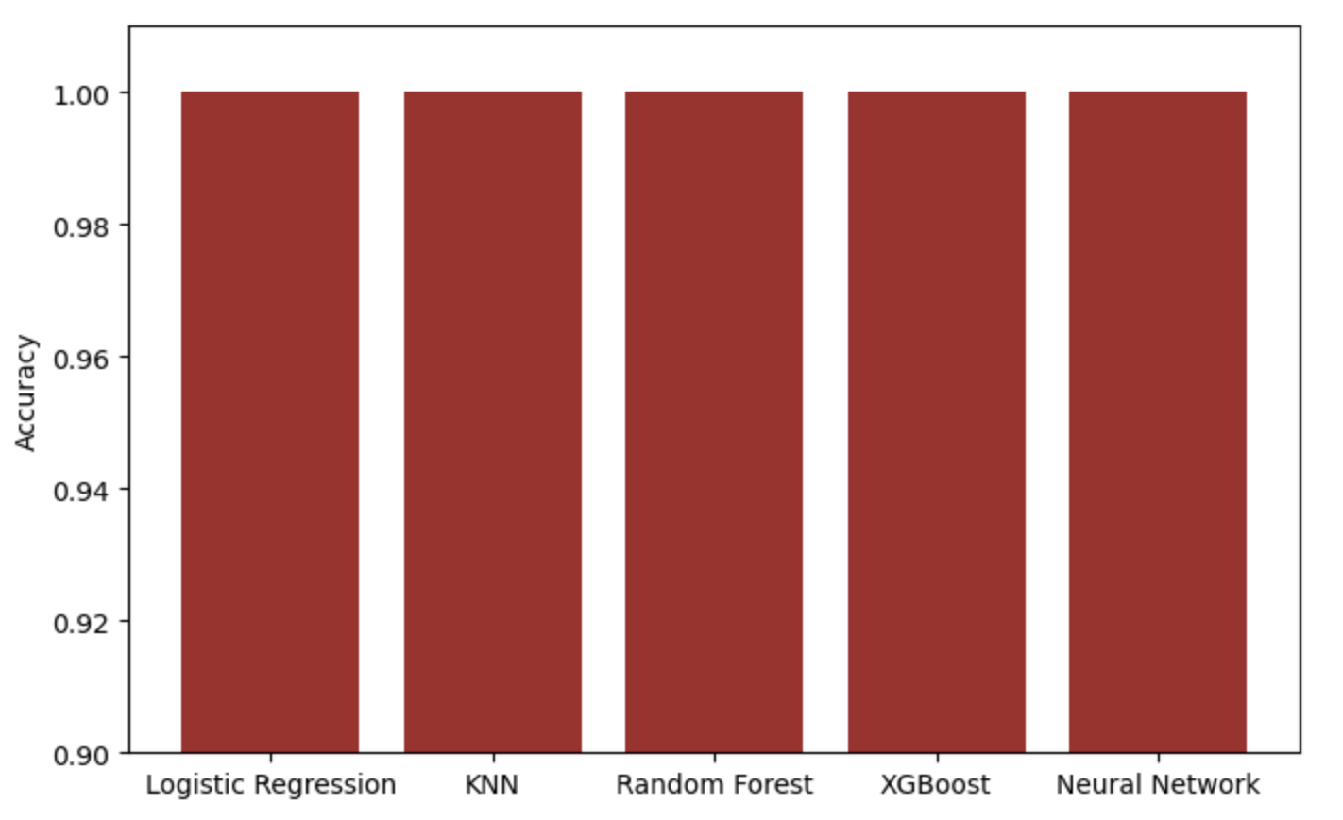
Model Comparison
All models achieved 100% accuracy. This suggests features exists that are highly predictive of class.

Slide 7
Feature Importance
– Used RandomForest to evaluate feature importance
– Most important feature: odor
– Dropped odor and retrained all models with the newly modified dataset

Slide 8
New Model Comparison
All models continued to achieve 100% accuracy despite removing the most important feature, suggesting that the dataset may contain other features that are individually or collectively sufficient for perfect classification. This also suggests possible redundancy in the dataset, meaning other features may carry overlapping or complementary predictive information. The dataset is very clean, well-labeled, and seperable.
Notes:
Model Complexity
Logistic Regression is simple and interpretable.
Decision Trees can overfit but are easy to visualize.
Random Forest and XGBoost are more complex but handle variance and bias well.
Neural Networks are highly flexible but overkill for simple problems.
Random Forest is the best balance of performance, robustness, and interpretability for this specific dataset.

